Slide 1
Kamlesh Kumar Singh Engineers Private Limited Where Work Is Worship An ISO 9001:2008 Company
Registered office:
H.No. 112, Refinery Township Road , Opp. Shiv Deep Public School, VPO- Dadlana, Panipat-132140, Haryana
Tel. & Fax :- 91 1802577927
Email: info@kksepl.com,kksepl@gmail.com
Website :www.kksepl.com

Slide 2
Kamlesh Kumar Singh Engineers Private Limited ( An ISO 9001:2008 Company)
Introduction
Company Details
List of key persons
Organization Structure
Areas of Activities
Client Details
List of Equipments
Work Executed in Last Five Years

Slide 3
Kamlesh Kumar Singh Engineers Private Limited Is incorporated under the provision of the Companies Act 1956. Our Company, Since Commencement of its Activities from 1989 executed various project work to the entire satisfaction of the clients. The company has earned a reputation of the Professional Competence, Business ethics and courage in accepting the challenging works. Our Specialty and Strength Strict Schedule Adherence Quality Control as per specification Most economic price structure skilled Manpower for effective and timely completion of work Maintaining HSE at all front up to standard.
Kamlesh Kumar Singh Engineers Private Limited ( An ISO 9001:2008 Company)

Slide 4
Kamlesh Kumar Singh Engineers Private Limited ( An ISO 9001:2008 Company)
Our People :
Our Team Consists many trained and highly experienced engineers with expertise in the fields of design, planning, cost estimation , sourcing, production, management and quality assurance & control. They are ably assisted by skilled technicians spread across our locations.
Our Facilities :
In addition, our production facilities match the best in the business. Among the key in- house facilities we have Plasma Arc Cutting Equipment, Pipe and plate bending, dish end forming, non-destructive testing, liquid penetrate testing, magnetic particle inspection, ultrasonic thickness gauging Painting.

Slide 5
Kamlesh Kumar Singh Engineers Private Limited ( An ISO 9001:2008 Company)
Company Details
S.No | Description | Registration Details
01 | PAN | AADCK5251H
02 | GST No. | 06AADCK5251H1ZO
03 | Provident Fund A/C No. | HR/KNL/36265
04 | ESIC No. | 13/45736/1001
05 | Boiler Certification | IAH/0144/2009
06 | Importer –Exporter Code (IEC) | 3309007812
07 | ISO 9001:2008 Certification | I/QSC-4574

Slide 6
Kamlesh Kumar Singh Engineers Private Limited ( An ISO 9001:2008 Company)
The Company is managed by following key persons :
Sr.No. | Name | Brief Description
1 | Mr.Kamlesh Kumar Singh Managing Director | An Engineering graduate, founder of this company having more than 25 years of experience in Construction business successfully.
2 | Mr. Birendra Kumar Singh Director Operations | Graduated as a Bachelor of Engineering and worming with this company since its inception. He is having more than 25 years of experience in the field of project operation.
3. | Mr. Anil Prasad Singh Director | On completion of bachelor of engineering worked with M/s Perton Engg. Construction Ltd for 25 years and with IOT Engg. Projects Ltd for more than 7 years. He associated with this company since 2013.

Slide 7
Kamlesh Kumar Singh Engineers Private Limited ( An ISO 9001:2008 Company)
Organizational Chart
Managing Director
Director
Operations
Director
Project Manager
HSE
Tender/Costing Estimation
Business Development
Resident Cons. Manager
Head HSE
Safety Manager
Human Resource
Finance
Quality Management

Slide 8
Organizational Strength
Human Resources
Present staff strength of this company is 550 professionally qualified in senior level/ mid level and junior level
At present company’s total workmen strength is around 6500 in the grade of highly skilled , skilled and semi skilled.
Industry Specific Training : The HR department implements policies for continued training.
Professionalism and Retention: Our HR policies focuses on incentives bonuses when a project milestone is reached.
Mentoring

Slide 9
Plant & Machinery Resources
Sn. | Description | Capacity | Unit | Quantity
1 | Hydraulic Bundle Extractor | 40 MT | NOS | 1
2 | Hydraulic Excavator |  | NOS | 2
3 | Mobile Crane 320 |  | NOS | 1
4 | Mobile Crane | 80 Ton | NOS | 1
5 | Pick & Carry Crane (F-15 or equivalent) | Up to 15 MT | NOS | 15
4 | Transit Mixer |  | NOS | 2
5 | Needle Vibrators | 6 Cu.m | NOS | 6
6 | Dumper | 6 Ton | NOS | 2
7 | Bar Cutting/ Bending Machine |  | NOS | 4
8 | Mixer Machine With Weigh Batcher |  | NOS | 2
9 | Water tankers |  | NOS | 4
10 | Total Station/Theodolite |  | NOS | 2

Slide 10
S.No | Description | Capacity | Unit | Quantity
11 | Dumpy/Auto Level |  | NOS | 4
12 | Plate Compactor |  | NOS | 2
14 | Diesel Generator Set | 45-250 KVA | NOS | 22
19 | Hydraulic torque wrench;1.5’’ Square Drive with deep groove socket of different sizes | UPTO 14000psi | NOS | 3
20 | Welding Machine |  | NOS | 560
21 | Grinding Machine |  | NOS | 350
22 | Hydraulic Jack |  | NOS | 25
23 | Hydro Testing Machine |  | NOS | 50
24 | Tractors & Tailors |  | NOS | 25
25 | Air Compressor |  | NOS | 1
26 | Plasma Cutting Machine |  | NOS | 5
27 | Office Containers |  | NOS | 15
28 | Torques Wrench |  | NOS | 3

Slide 11
Company’s Financial Record
Financial Year
2014-2015
INR 38,40,08,721
Financial Year
2015-2016
INR 57,20,45,993.00
Financial Year
2016-2017
INR 84,09,30,941.00

Slide 12
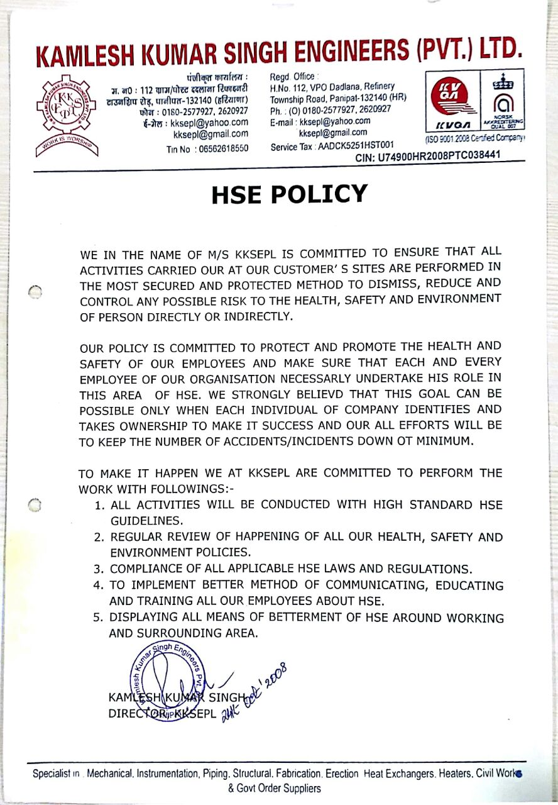
KKSEPL’S Policy & Achievements
KKSEPL’s Quality and HSE Policy objectives
We At KKSEPL are committed to :
Deliver high quality Products & Services conforming to specifications/ regulations of national/ international standards through continual improvement in Quality Management System.
Ensure ON TIME delivery to customers.
Imparting Health, safety training and PPE to our employees on the basis of site requirements to ensure Zero Loss Time Injuries at site.
Strictly follow “ Health Safety & Environment (HSE)’’ policy .

Slide 13
QA/QC Policy
KKSEPL’s Quality Assurance and control function is systematically applied by a cadre of highly trained and qualified inspection personnel led by our corporate examiner to ensure 100% compliance requirement
During the last five years company has managed to deliver quality products with zero defect as per industrial standard up to the mark of various clients , Company strictly followed the QA/QC policy set-up by their higher management , which is displayed here:

Slide 14
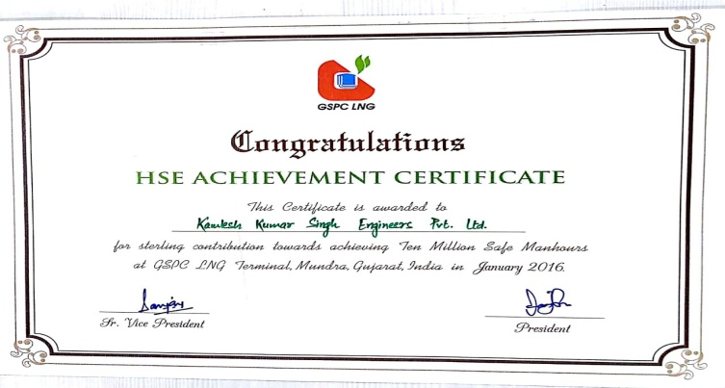
Achievements
During the last five years company has managed to achieve 10 million zero loss of man-days in various projects spread out in India. Few appreciation certificates are displayed below

Slide 15
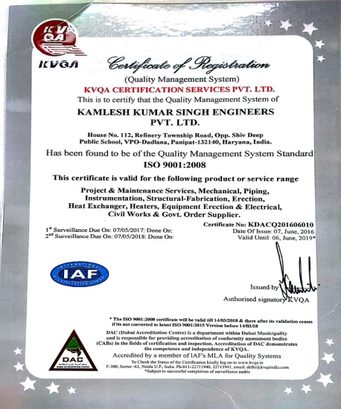

Slide 16
Kamlesh Kumar Singh Engineers Private Limited ( An ISO 9001:2008 Company)
Activities
1. Execution of Mechanical Work
The company is involved in executing grass root Mechanical work related with fabrication erection of utilities and process piping, installation and alignment of rotary/ static equipments such as pumps, blowers, compressor, heat exchangers etc, fabrication and erection of structural work related with pipe rack and technological structure of plant. Major Such job executed by us during recent past are listed for information elsewhere in this presentation
2. Execution of Civil Work
M/s KKSEPL is also involved in executing associated industrial civil work required for specific plant. This Specific expertise of company avoid implementation of multi agencies for individual plant and provides better coordination for our Clients.

Slide 17
3.Execution of Heavy lift
Company During its experience has executed various critical lifts which call for involvement of heavy duty crane, High standard rigging along with précised lifting tackles. Few of Such Lifts along with their photographs are attached.
Haldia ( photographs) 160 T
DHDT ( IOCL Baroda) 70 T
DHDS Reactor and V 25 (200T &225 T resp.)
Panipat
4. Execution of Revamp Work
M/s KKSEPL has successfully executed few of revamp works, which are Critically time bounded and directly related with Refinery Production , Such Revamp work involved multi discipline scope and massive resource deployment related with Man- Power, Supervisors and Plant & machineries.
5. Execution of Electrical & Instrumentation
M/s KKSEPL is also capable of executing E& I works required for specific plant which excludes deployment of separate agency and provides Single point coordination for Client.

Slide 18
Storage Tanks & Chimney
We fabricate and install highest quality storage tanks and proactive services as per the specifications of our clients. We have got the complete manufacturing facilities for all types of stainless steel fabrication of the highest quality to meet any requirement of any plant or project as per drawing and design in various shapes like:
Horizontal Storage tanks ( Floating Roof & Fixed Roof)
Vertical Storage tanks
Elliptical shaped Storage tanks
Dished Shaped Storage tanks
Flat Storage tanks
Conical Head Storage tanks
Its further stainless steel equipment could be pressure vessels or any other tanks required for industries.
We offer our clients a wide array of industry standard storage tanks made from stainless steel , MS, Hastelloy, Titanium and Nickel. It is available in wide capacities ranging from 500 liters to 70,000 liters. We offer variety of storage tanks including Vertical and Storage Tanks. Available in Various specifications, the collection is made available to our clients as per their requirements . The Vertical Storage tanks are variedly used in chemical and pharmaceutical industries.

Slide 19
Major milestones achieved
Though M/s KKSEPL has successfully completed many projects from inception to till date with various reputed clients, some of projects highlights are given below.
Revamp of CDU/VDU of IOCL, Panipat Refinery ( P-15 ) Project.
Structural Works for INDMAX- FCC & PRU ( EPCM-4) for IOCL Paradip Refinery.
Composite works for feed preparation unit (FPU) of IOCL,Haldia Refinery.
Structure Equipment and Piping Fabrication erection of MEG Unit of Reliance Refinery and Petrochemical Complex at Jamnagar, Gujarat.
Revamp Work Of DHDT unit of Gujarat Refinery at Baroda under BS-IV project.
Alloy Steel Piping Works under LSTK-C of Paradip refinery Project at Paradip, Odisha.
Praxair Paradip Project Carried out Equipment, Piping Fabrication/ Erection job on back to back basis for Hydrogen Reformer Project, Paradip.

Slide 20
Composite works for feed preparation unit (FPU) of IOCL,Haldia Refinery.
Structure Equipment and Piping Fabrication erection of MEG Unit of Reliance Refinery and Petrochemical Complex at Jamnagar, Gujarat.
Structural Works for INDMAX- FCC & PRU ( EPCM-4) for IOCL Paradip Refinery.
Revamp Work Of DHDT unit of Gujarat Refinery at Baroda under BS-IV project.
Revamp of CDU/VDU of IOCL, Panipat Refinery ( P-15 ) Project.

Slide 21
Composite Works for DHDS & SWS-VI Unit for BS –IV Projects at Gujarat Refinery
Combined station works for conversion of existing underground piping in old tank farm to above ground piping along with associated work at Vadinar
Alloy Steel Piping Works under LSTK-C of Paradip refinery Project at Paradip, Odisha.
Praxair Paradip Project Carried out Equipment, Piping Fabrication/ Erection job on back to back basis for Hydrogen Reformer Project, Paradip.

Slide 22
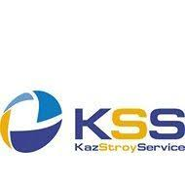
Client’s Details

Slide 23
Kamlesh Kumar Singh Engineers Private Limited ( An ISO 9001:2008 Company)
Work Executed In Last Five Years
Sr. No. | Name of the Work & WO No. | Client’s Name | Executed Value (LACs) | Year Of Completion
1 | Additional structural works for INDMAX (FCC) & PRU (EPCM-4) of Paradip Refinery Project | IOCL. Paradip. Odisha | 3971.00 | 2014
2 | Equipment, Piping fabrication/erection job for Hydrogen Praxair projects | IOCL, Paradip. Odisha | 1511.36 | 2014
3 | Alloy Steel Piping works | IOCL, Paradip, Odisha | 1831.00 | 2015
4 | Mech. Works including piping, structural, equipment erection,insulation & Painting works for CDU/VDU unit | IOCL, Panipat, Haryana | 2351.00 | 2011
5 | Mechanical Works For Butene-1 Project at PNCP,IOCL | IOCL, Panipat, Haryana | 1714.69 | 2014
6 | Mechanical, equipment and piping works for FCCU & PRU revamp project | IOCL, Mathura, UP | 1326.84 | 2014
7 | Mechanical Works for ISRL, Panipat , Haryana | Indian Synthetic Rubber ltd, Panipat | 1633.80 | 2013

Slide 24
Sr.NO | Name of the Work | Client’s Name | Executed Value | Year of Completion
8 | Structural Steel Works at BASF project, Dahej , Gujarat | BASF , Dahej | 642.96 | 2014
9 | AG Piping Works for BASF project Dahej, Gujarat | BASF, Dahej | 781.14 | 2014
10 | UG Piping works at PDR3 project Dahej, Gujarat | BASF, Dahej | 211.48 | 2015
11 | Civil & Structural works for sub station building for coke chamber replacement & allied modernization | IOCL, Barauni, Bihar | 822.00 | 2016
12 | Composite works for Mechanical, civil & structure jobs for Feed Preparation Unit (FPU) at Haldia Refinery | IOCL, Haldia, West Bengal | 2933.18 | 2016
13 | Structure, Erection, Equipment erection & AG piping field fabrication and erection work, HPIN unit | Reliance Industries Ltd. Jamnagar, Gujarat | 3631.00 | 2017
14 | Structural Erection , equipment erection & AG Piping field fabrication and erection work, MEG unit | Reliance Industries Ltd. Jamnagar, Gujarat | 2700.00 | In progress
15 | Composite works for DHDS & SWS-VI unit for BS-IV project, IOCL,Gujarat | IOCL, Gujarat, Refinery | 4055.31 | In Progress

